Slide 1
WEB APPLICATION BASED DIABETES PREDICTION USING MACHINE LEARNING

Slide 2

OBJECTIVE
Our objective is to design an interactive webpage/application in which user can give a input for the prediction of the diabetes by using ML algorithms and ensemble techniques.
To compare K-Nearest Neighbour and Random Forest Classifier. Then boost the accuracy of the best model.

Slide 3

INTRODUCTION
Diabetes is one of the most common disease worldwide and keeps increasing everyday due to changing life styles, unhealthy food habits and over weight problems.
There were many studies handled in predicting diabetes through physical and chemical tests, are available for diagnosing diabetes.
Data science methods have the potential to benefit other scientific fields by shedding new light on common questions.

Slide 4
PROBLEM FORMATION
Identify the strengths and weaknesses of each of the existing methods for predicting diabetes.
Select an appropriate method based on the available data and prediction requirements.
Define appropriate evaluation metrics to assess the accuracy and reliability of the chosen method.

Slide 5
EXISTING METHOD
Decision trees use a tree-like model, KNN relies on similarity measures, and MLP uses a network of artificial neurons.
Decision trees are easy to interpret but can overfit, KNN is simple but sensitive to metrics, and MLPs can learn complex relationships but require resources.
Decision trees for small datasets, KNN for many data points, and MLPs for complex data structures.

Slide 6
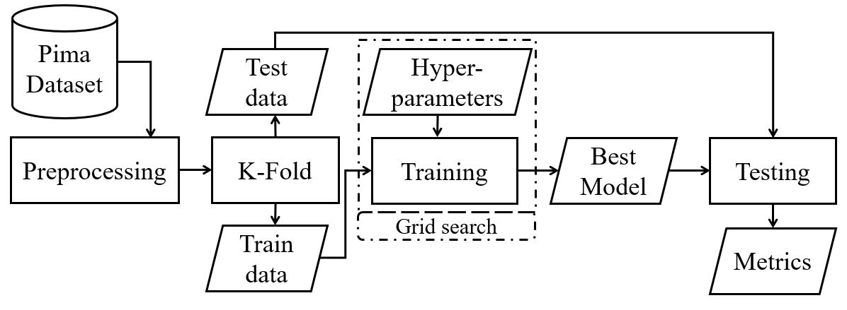
EXISTING METHOD BLOCK DIAGRAM

Slide 7
PROPOSED METHODOLOGY
Here we are using the machine learning algorithms such as KNN and Random Forest Classifier to predict the diabetes and other ensemble techniques are also used.
The prediction of diabetes is fully based on the web application, where we are creating a web page for the diabetes prediction.
If we give the inputs manually, then the web page will shows the results.

Slide 8
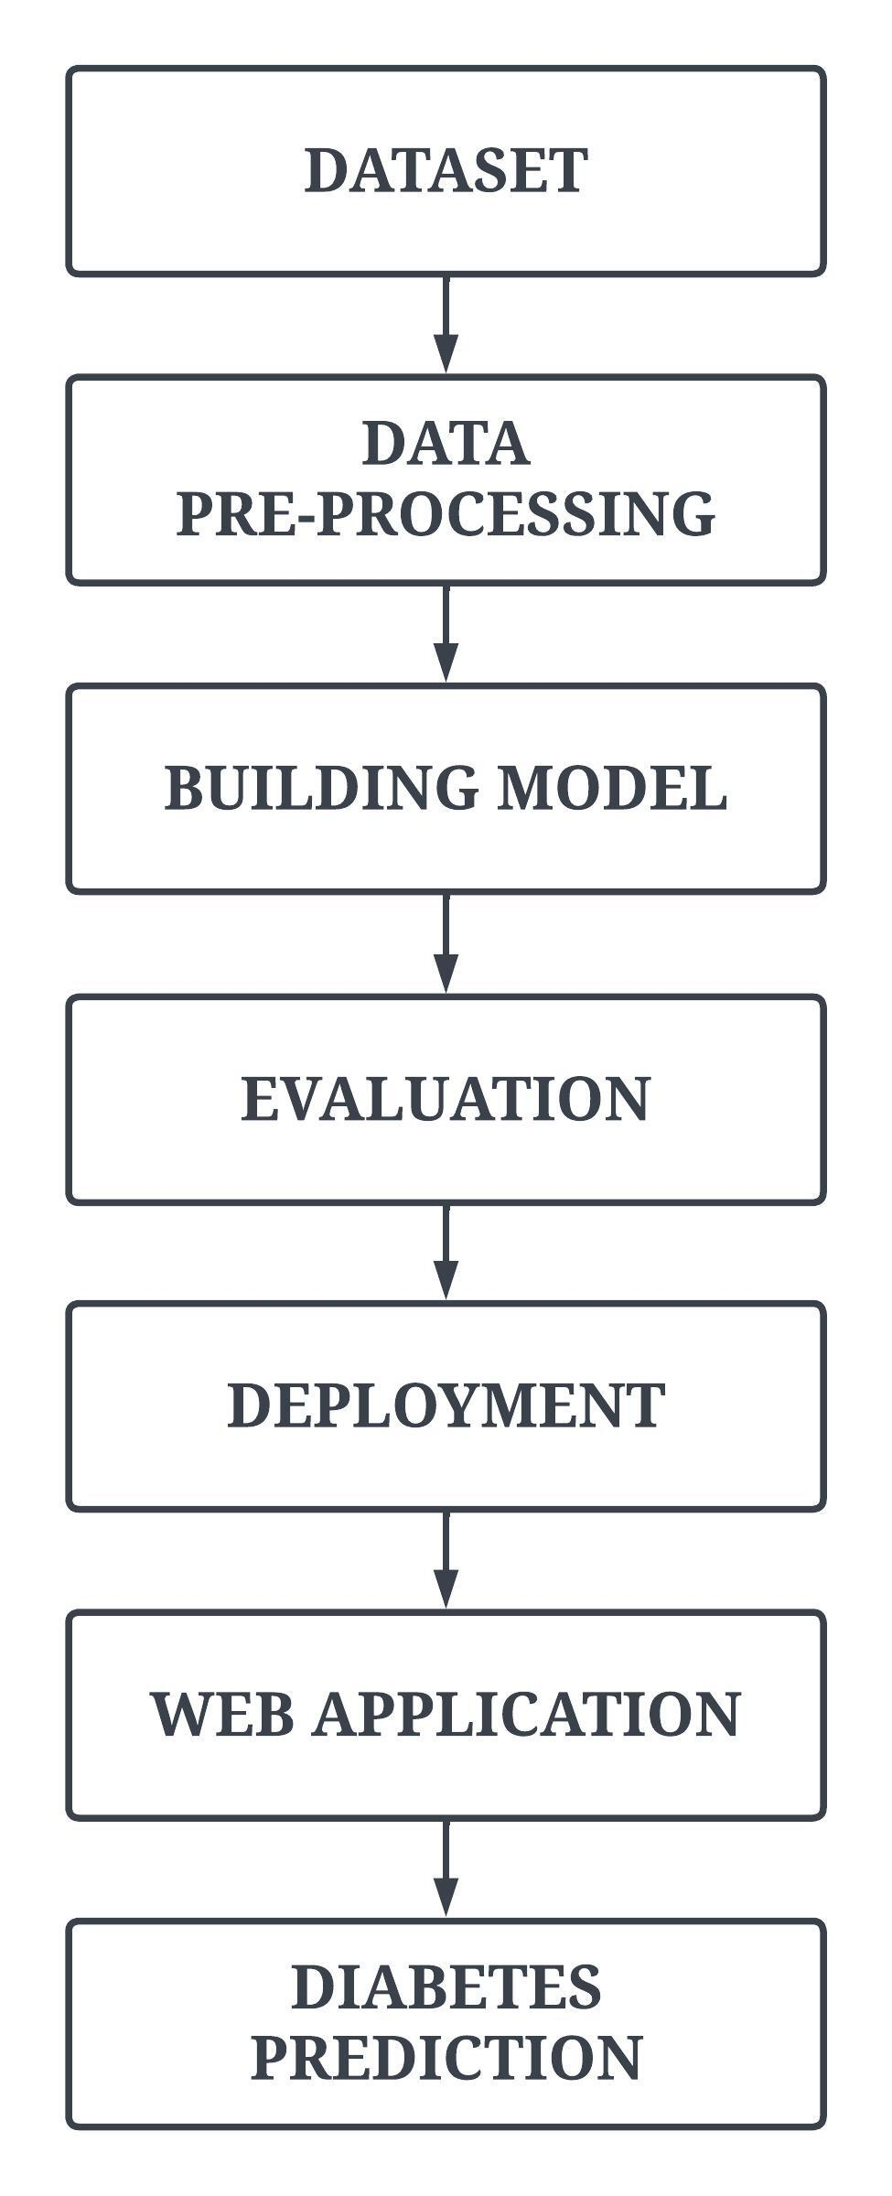

BLOCK DIAGRAM

Slide 9
PIMA DATASET
FEATURES | DESCRIPTION | VALUE
Pregnancies | Shows how many pregnancies the woman experienced | 0 - 17
Glucose Level | It represents the glucose levels(mg/dl) of the person | 0 - 199
Blood pressure | It represents the blood pressure(mmHg) of the person | 0 - 122
Skin Thickness | This quantity (mm) shows the skin thickness of the person | 0 - 99
Insulin | This quantity (mu U/ml) shows the rate of insulin in the blood for two hours | 0 - 846
BMI | It stands for the Body Mass Index and serves as a gauge for someone's wellbeing | 0 - 67
DiabetesPedigreeFunction | It serves as a marker for a family history of diabetes | 0.08 - 2.24
Age | The age is shown in years | 1 - 81
Outcome | Indicates if the patient has diabetes or not | 0 or 1

Slide 10
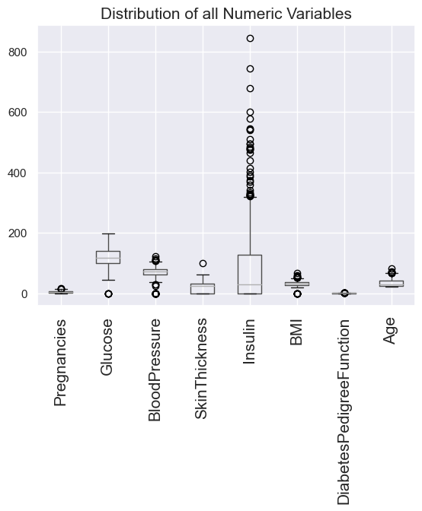
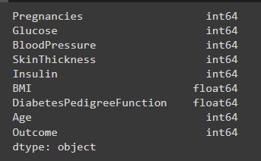
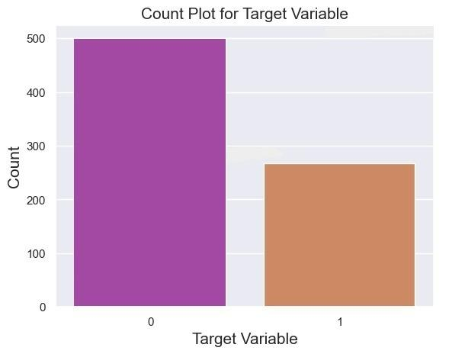

Slide 11
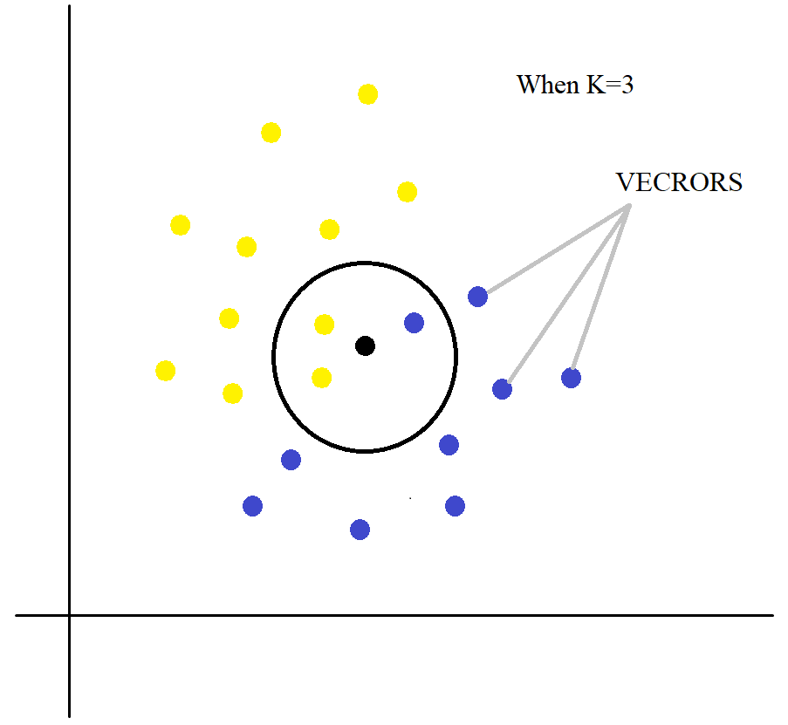
K-NEAREST NEIGHBOUR
KNN classifies new data points based on their proximity to the k nearest training data points using Euclidean or Manhattan distance.
KNN uses a voting mechanism to classify new data points based on the class with the highest number of votes among the k nearest neighbors, with a weighted voting scheme used for ties.
KNN stores all training data points for classification, making it computationally expensive for large datasets, but allowing for real-time predictions once trained.

Slide 12
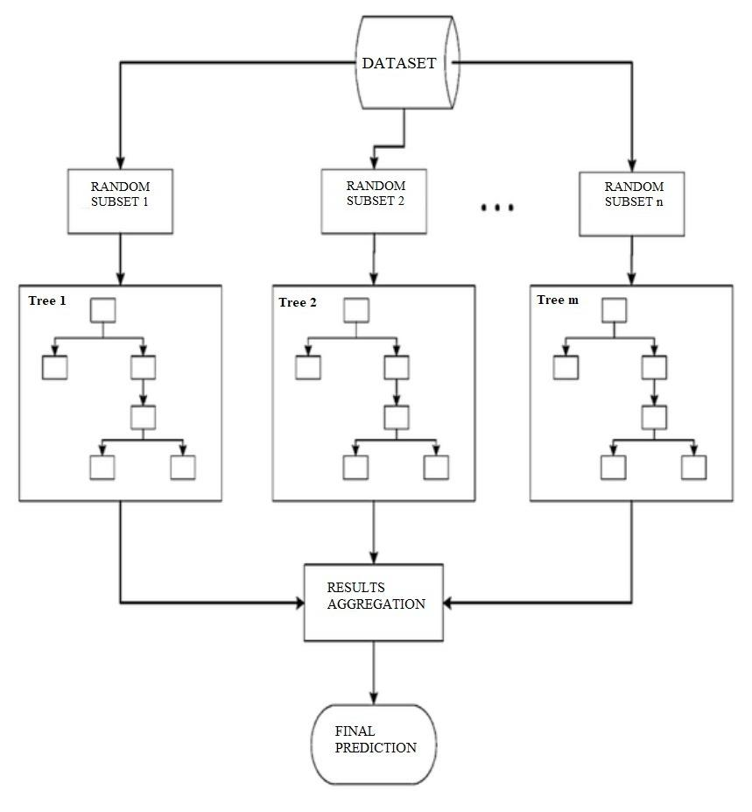
RANDOM FOREST CLASSIFIER
Random Forest Classifier is an ensemble learning method that combines multiple decision trees for better prediction performance.
Random Forest Classifier can provide information about feature importance, which is useful in feature selection and understanding data patterns.
Hyperparameter tuning is essential for optimizing the performance of Random Forest Classifier.

Slide 13
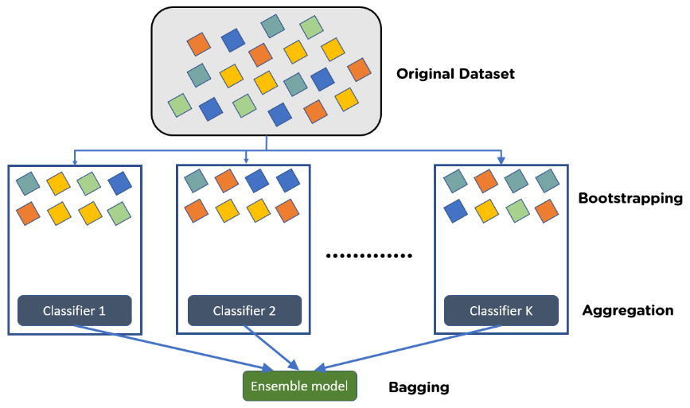
BAGGING META - ESTIMATOR
Bagging (Bootstrap Aggregating) is a meta-estimator that uses bootstrapping to create multiple samples of the training data and fits an estimator on each sample.
The algorithm then aggregates the results of the estimators to make a final prediction. This can help reduce overfitting and increase the model's stability and accuracy.

Slide 14

MERITS AND DEMERITS
Robust to overfitting
Good for high-dimensional data
High accuracy
Requires careful hyperparameter tuning
Sensitive to noisy data

Slide 15
RESULT AND DISCUSSION
Here we are expecting the accurate prediction of the diabetes.
Through the usage of various Machine learning models and selecting the best model for the prediction of the diabetes.
As a result, it is easy to predict the diabetes, if this system is implemented in the laboratories where the blood samples are collected and processed.
Model | Accuracy Score
KNN | 75.33%
Random Forest Classifier | 81.81%
Random Forest Classifier with Bagging Meta-estimator | 83.11%

Slide 16
RESULT TABULATION
Model | AUC Score | Precision Score | Recall Score | Accuracy Score | f1-Score
K-Nearest Neighbour | 0.7552 | 0.7636 | 0.7826 | 0.76 | 0.7730
Random Forest Classifier | 0.7643 | 0.6888 | 0.6595 | 0.8051 | 0.6739
Bagging Meta-estimator(RF) | 0.7783 | 0.7380 | 0.6595 | 0.8311 | 0.6966

Slide 17
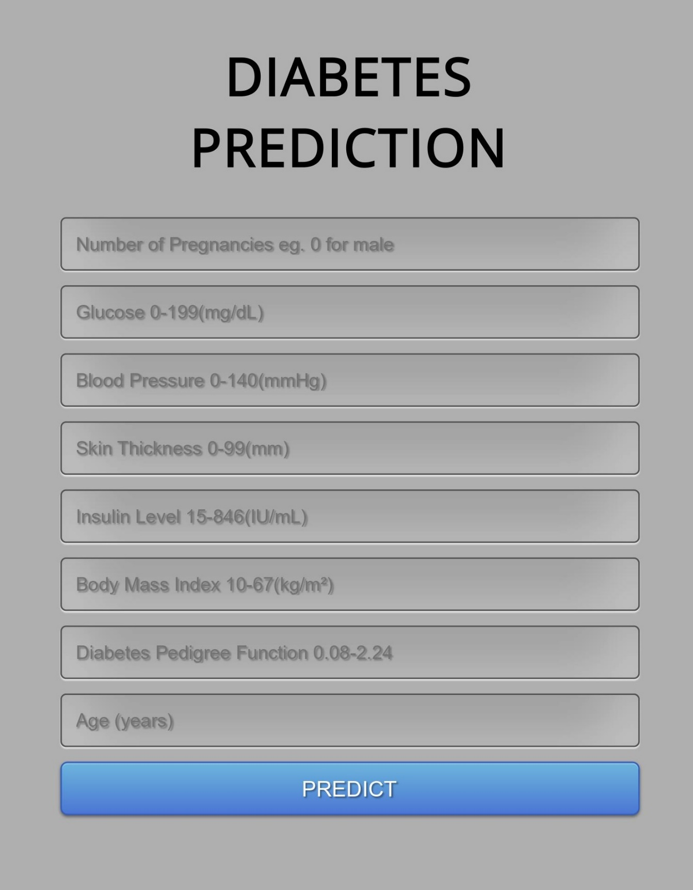
WEB APPLICATION

Slide 18
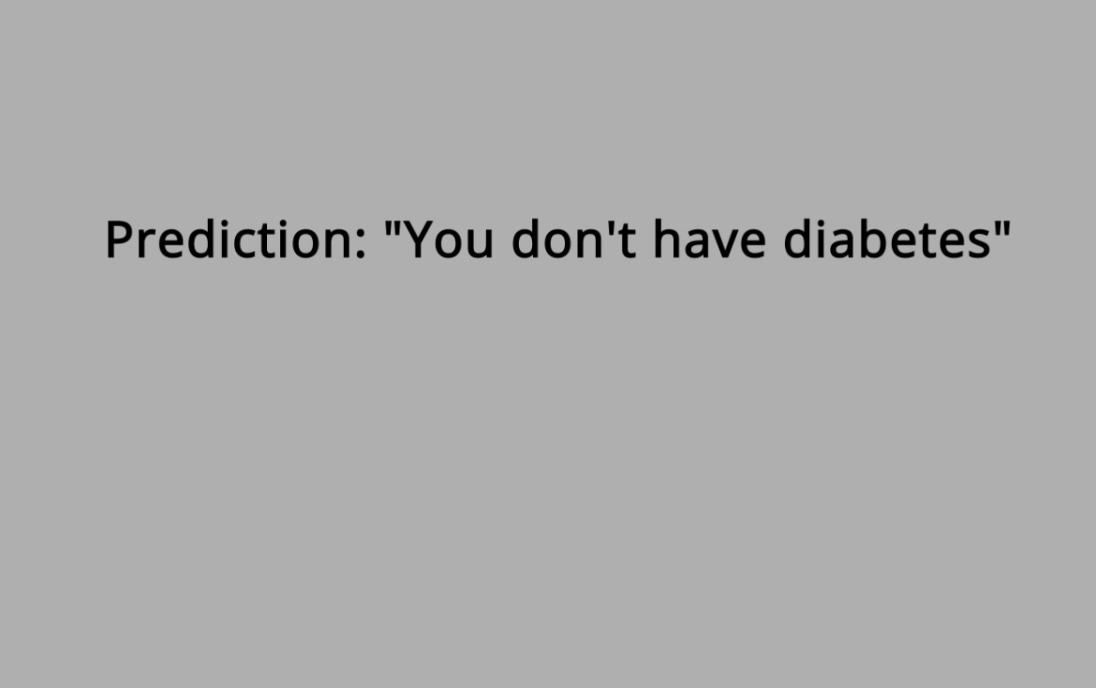
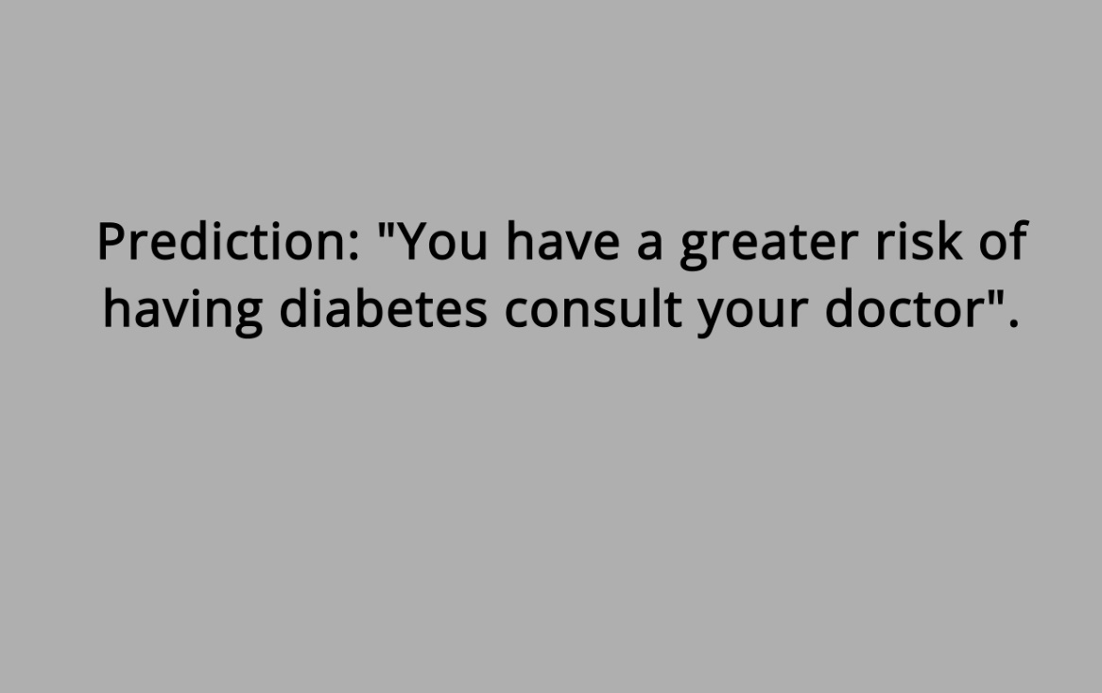
PREDICTION
NEGATIVE
POSITIVE

Slide 19

APPLICATIONS
Early detection and prevention
Personalized treatment
Resource allocation
Public health interventions
Research

Slide 20
CONCLUSION AND FUTURE WORK
The development of a web application-based diabetes prediction system using machine learning by comparing the KNN and the Random Forest Classifier is proposed.
The Random Forest (RF) classifier with Bagging Meta-Estimator outperforms the K-Nearest Neighbors (KNN) machine learning algorithm on the Indian Pima Dataset.
It can be used in the medical field for the identification of diverse medical facts with high accuracy.
As proposed, a web application for diabetes prediction based on an ML algorithm was developed.
In the near future, this proposed work will concentrate on creating a dataset based on location from actual data using a deep learning model in order to accurately anticipate diabetic situations.

Slide 21
THANK YOU

